Slide 1
PROBABILITY SAMPLING IMPLEMENTED IN PYTHON

Slide 2
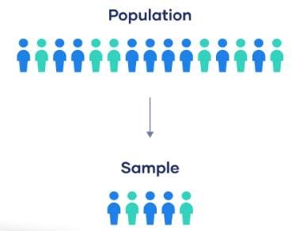

POPULATION:
A population is the entire group that you want to draw conclusions about.
A sample is the specific group that we collect from population to represent the entire population.
The size of the sample is always less than the total size of th population.
Sampling is a method that allows that represents the information about the population based on results from sample.
Sampling is categorized into 2 types:
Probability Sampling
Non Probability Sampling
e

Slide 3
PROBABILITY SAMPLING:
Probability sampling refers to the selection of a sample from a population, when this selection is based on the principle of randomization, that is, random selection or chance.
When choosing a probability sample design, the goal is to minimize the sampling error of the estimates for the most important survey variables, while simultaneously minimizing the time and cost of conducting the survey.
There are several different ways in which a probability sample can be selected. They are:
Random Sampling
Systematic Sampling
Stratified Sampling
Cluster Sampling

Slide 4
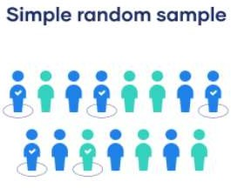
RANDOM SAMPLING:
In random sampling, every member of the population has an equal chance of being selected.
The sampling frame should include the whole population.

Slide 5
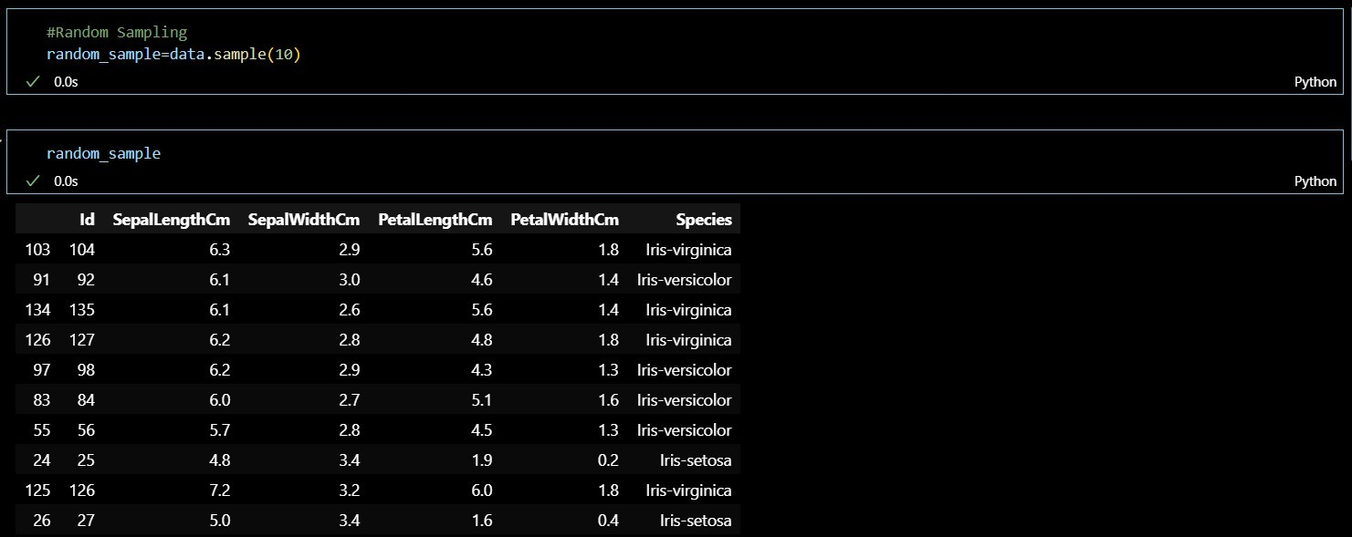

Slide 6
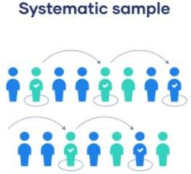
SYSTEMATIC SAMPLING:
Systematic sampling is similar to simple random sampling, but it is usually slightly easier to conduct.
Every member of the population is listed with a number, but instead of randomly generating numbers, individuals are chosen at regular intervals.

Slide 7
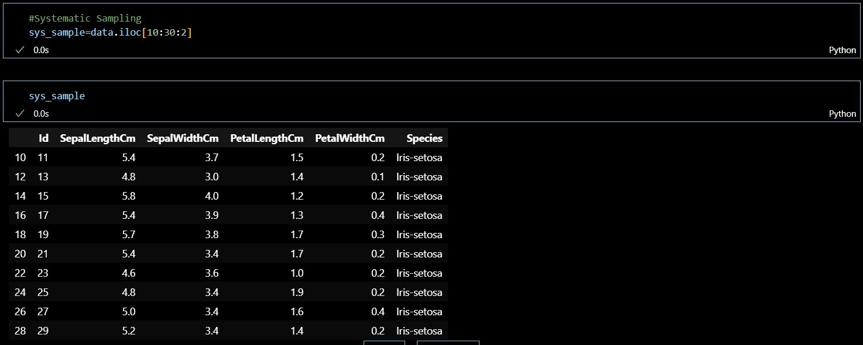

Slide 8
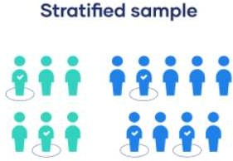
STRATIFIED SAMPLING:
Stratified sampling involves dividing the population into subpopulations that may differ in important ways.
It allows us to draw more precise conclusions by ensuring that every subgroup is properly represented in the sample.
To use this sampling method, we divide the population into subgroups (called strata) based on the relevant characteristic (e.g., gender identity, age range, income bracket, job role).
Based on the overall proportions of the population, we calculate how many people should be sampled from each subgroup. Then we use random or systematic sampling to select a sample from each subgroup.

Slide 9
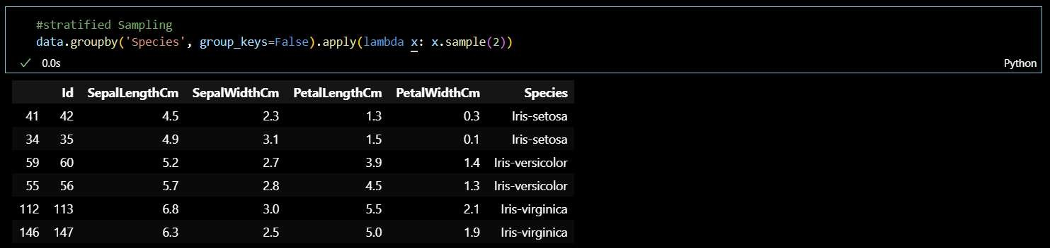

Slide 10
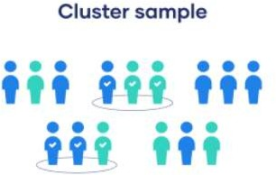
CLUSTER SAMPLING
Cluster sampling also involves dividing the population into subgroups, but each subgroup should have similar characteristics to the whole sample.
Instead of sampling individuals from each subgroup, we randomly select entire subgroups.
If it is practically possible, we might include every individual from each sampled cluster.
If the clusters themselves are large, we can also sample individuals from within each cluster using one of the techniques above.

Slide 11
